Slide 1

Design of Biomedical Measurement Systems

Slide 2

https://github.com/jeffliu123/Biomedical_assignment

Slide 3

Run the project on ubuntu system

Slide 4

Install anaconda

Slide 5

Text editor we choose vscode

Slide 6

STM32CubeIDE is the official IDE released by STMicroelectronics for STM32 development.

Slide 7
First step create a virtual environment
$ conda create --name DL python=3.9
Type above instruction in your terminal (python version 3.9 virtual environment name DL)

Slide 8
Second step Install the required packages
$ pip install -r requirements.txt
Type above instruction in your terminal
pySerial == 3.5,keyboard == 0.13.5,tensorflow==2.13.0,numpy==1.24.3,
pandas==2.0.3,wfdb==4.1.2,seaborn==0.12.2,matplotlib==3.7.3,
keras==2.13.1,scikit-learn==1.3.1

Slide 9
Usage
$ python3 assignment1.py
$ python3 assignment2.py
$ python3 cnn_predict.py
$ python3 assignment4.py

Slide 10
Assignment 1:
1.Plot ecg signal
2.Plot ppg signal
3.Calculate Pulse Rate

Slide 11
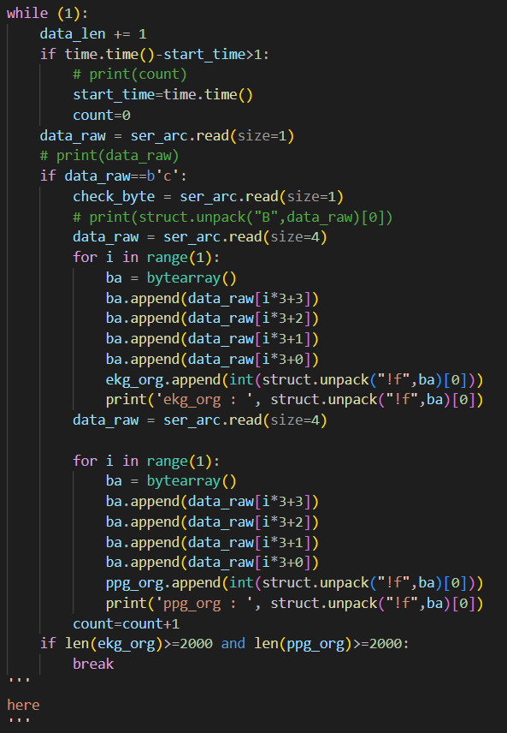

Slide 12
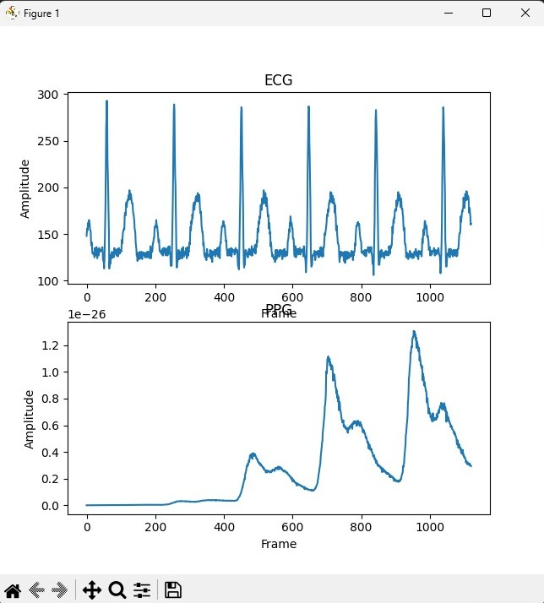
PPG

Slide 13
Demo time

Slide 14
Assignment 2:
1.Fill some layers of the model on your own
2.Draw the training and validation loss
3.Save testx.npy and testy.npy(prepare for Lab4)

Slide 15
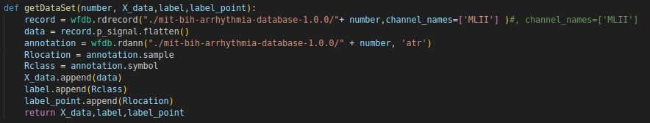

Slide 16
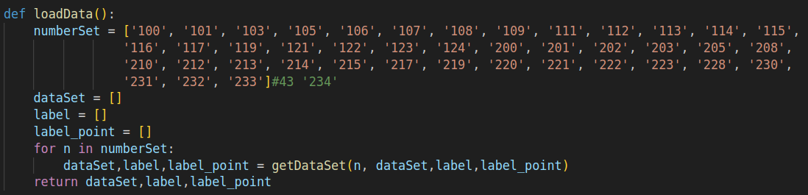

Slide 17
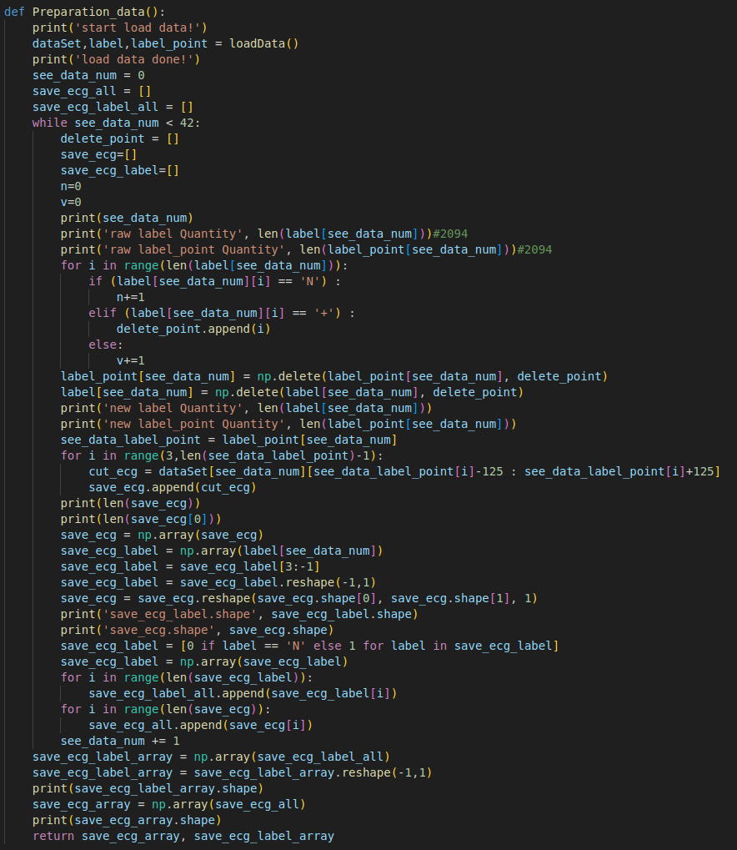

Slide 18
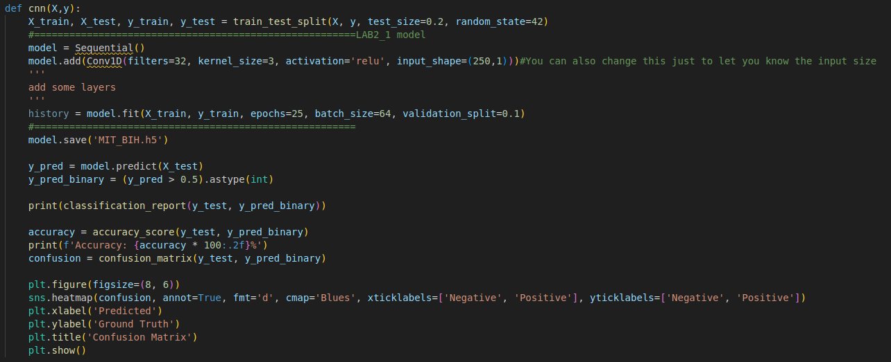

Slide 19
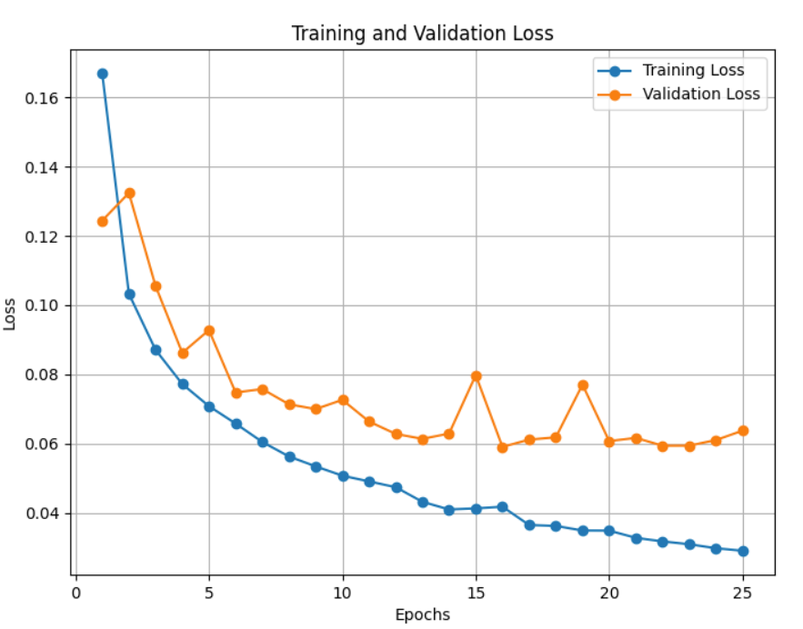

Slide 20
Demo time

Slide 21
Assignment 3:
1.Transfer MIT_BIH.h5 to MIT_BIH.tflite write the code
2.Write function to load tflite model

Slide 22
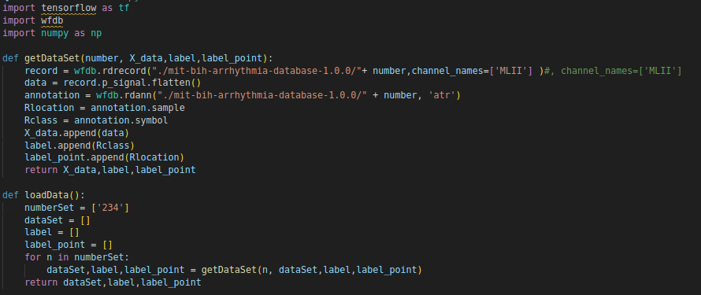

Slide 23
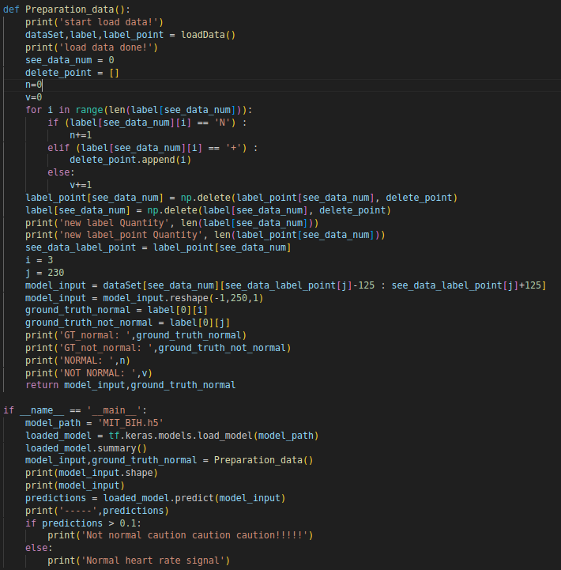

Slide 24
Demo time

Slide 25
Assignment 4:
1.Shrink tflite model to smaller size
2.Compare two model size MIT_BIH.tflite and MIT_BIH_quant.tflite
3.Try the model on the embedded system and run the code

Slide 26
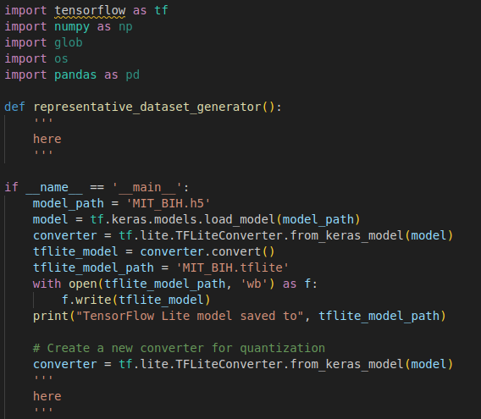

Slide 27
Download representative dataset
$ sh download.sh

Slide 28
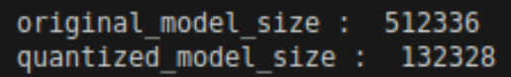

Slide 29
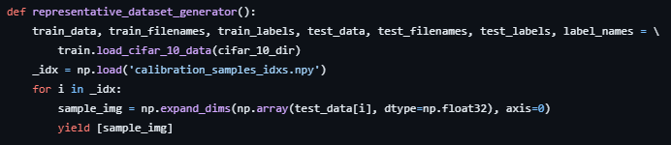
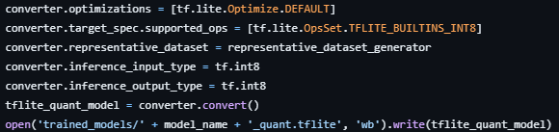

Slide 30
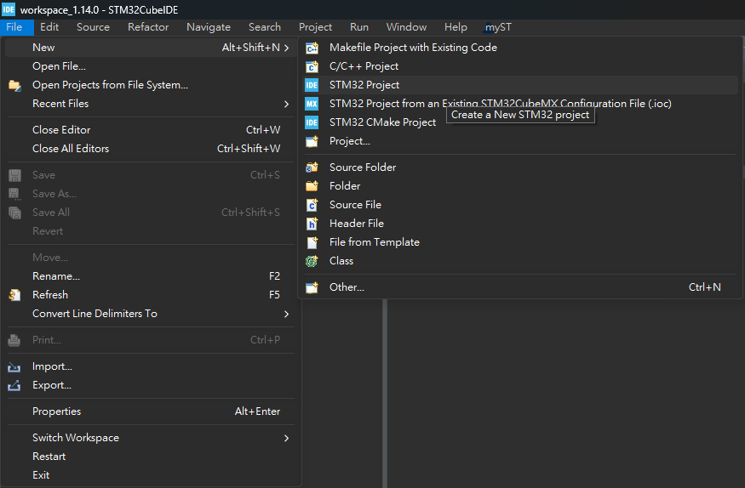
Create STM32 Project

Slide 31
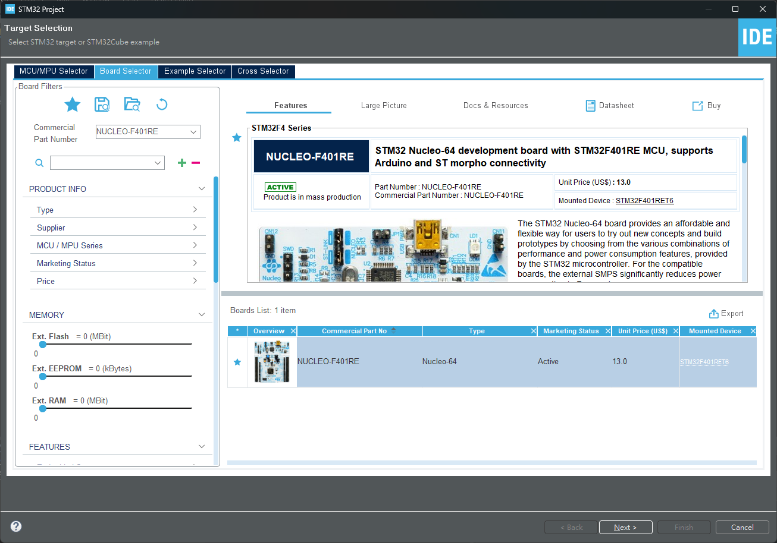
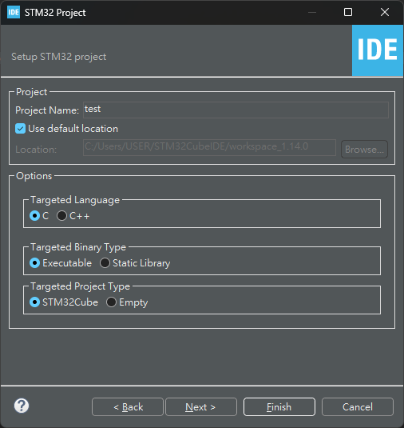
Create STM32 Project

Slide 32
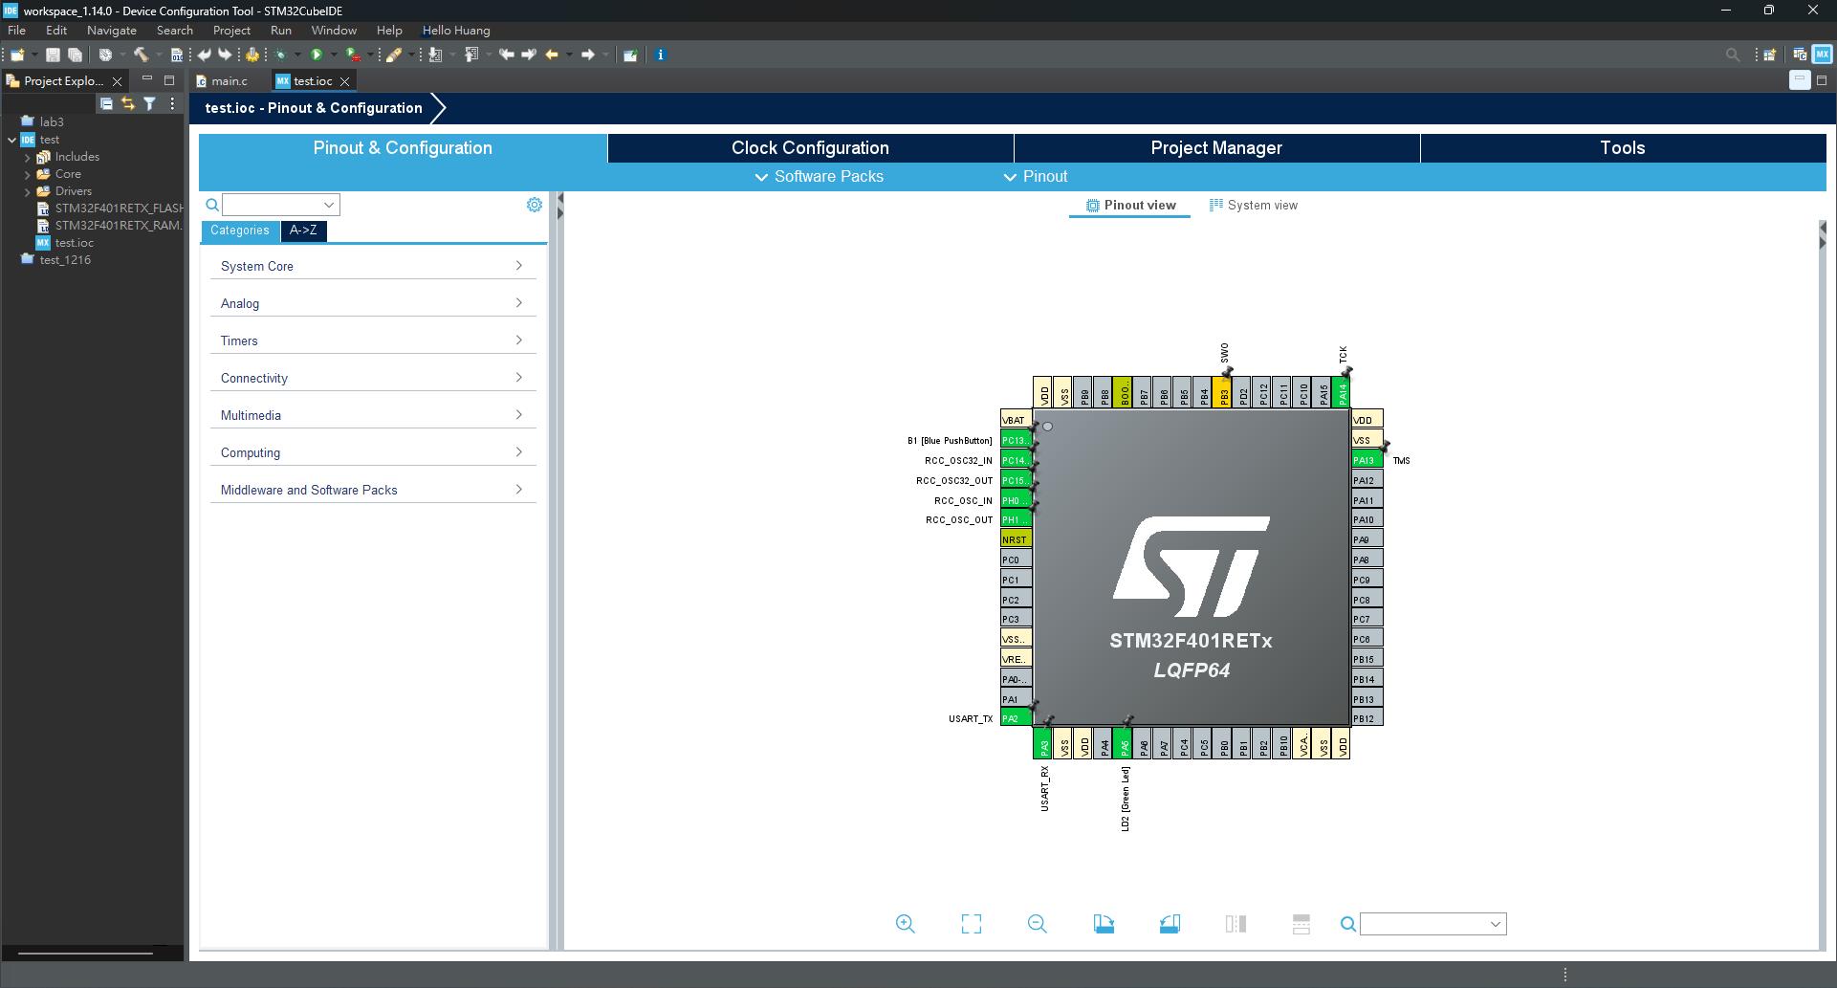
Create STM32 Project
Notes:
左邊是IDE編譯器，自動產生的底板程式碼，
右邊是CUBEMX軟體介面，可對開發板硬體資源進行設定。

Slide 33
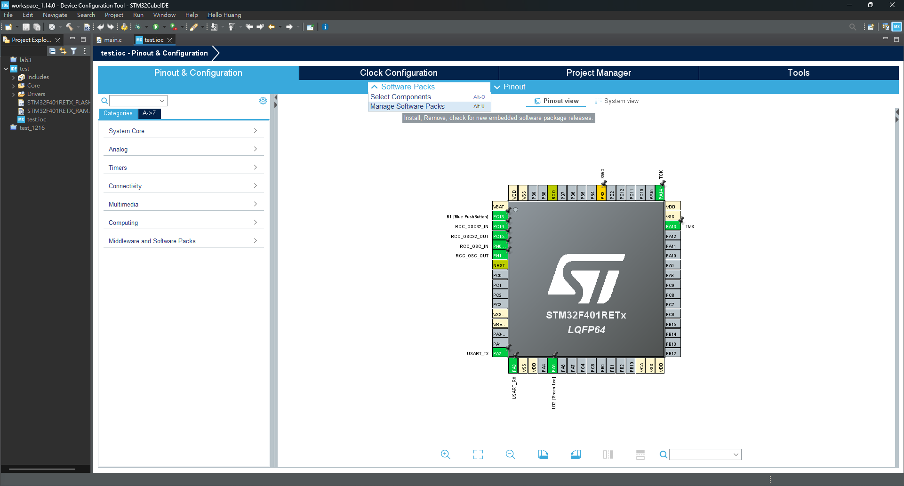
Install X-CUBE-AI
Notes:
下載AI開發所需的software packs

Slide 34
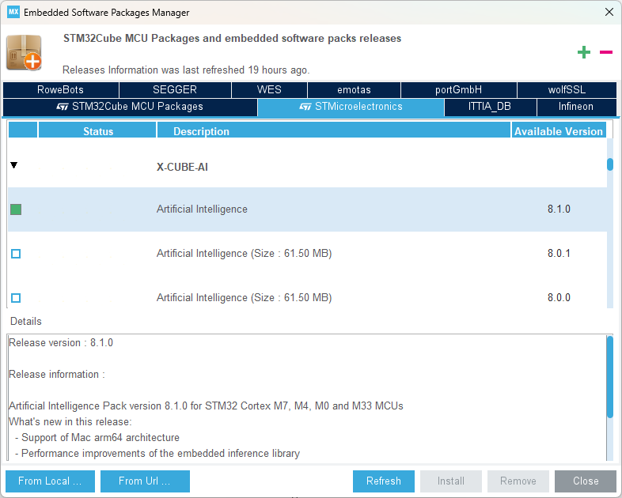
Install X-CUBE-AI

Slide 35
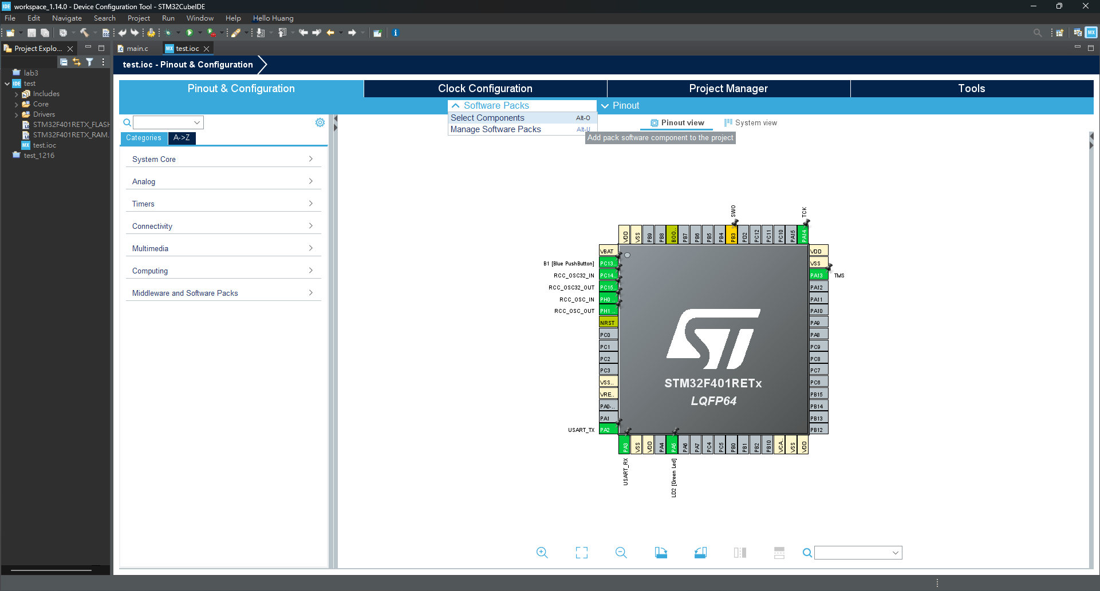
Select X-CUBE-AI

Slide 36
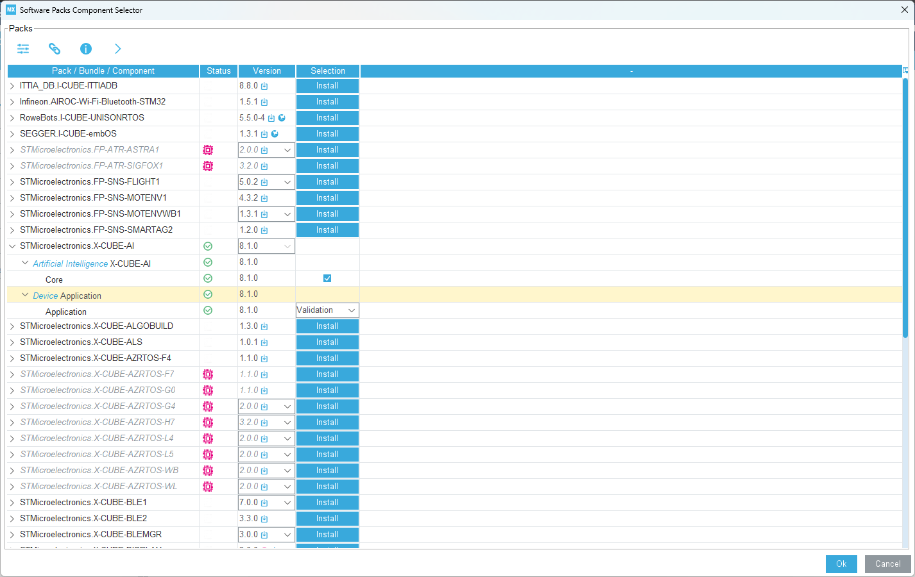
Select X-CUBE-AI

Slide 37
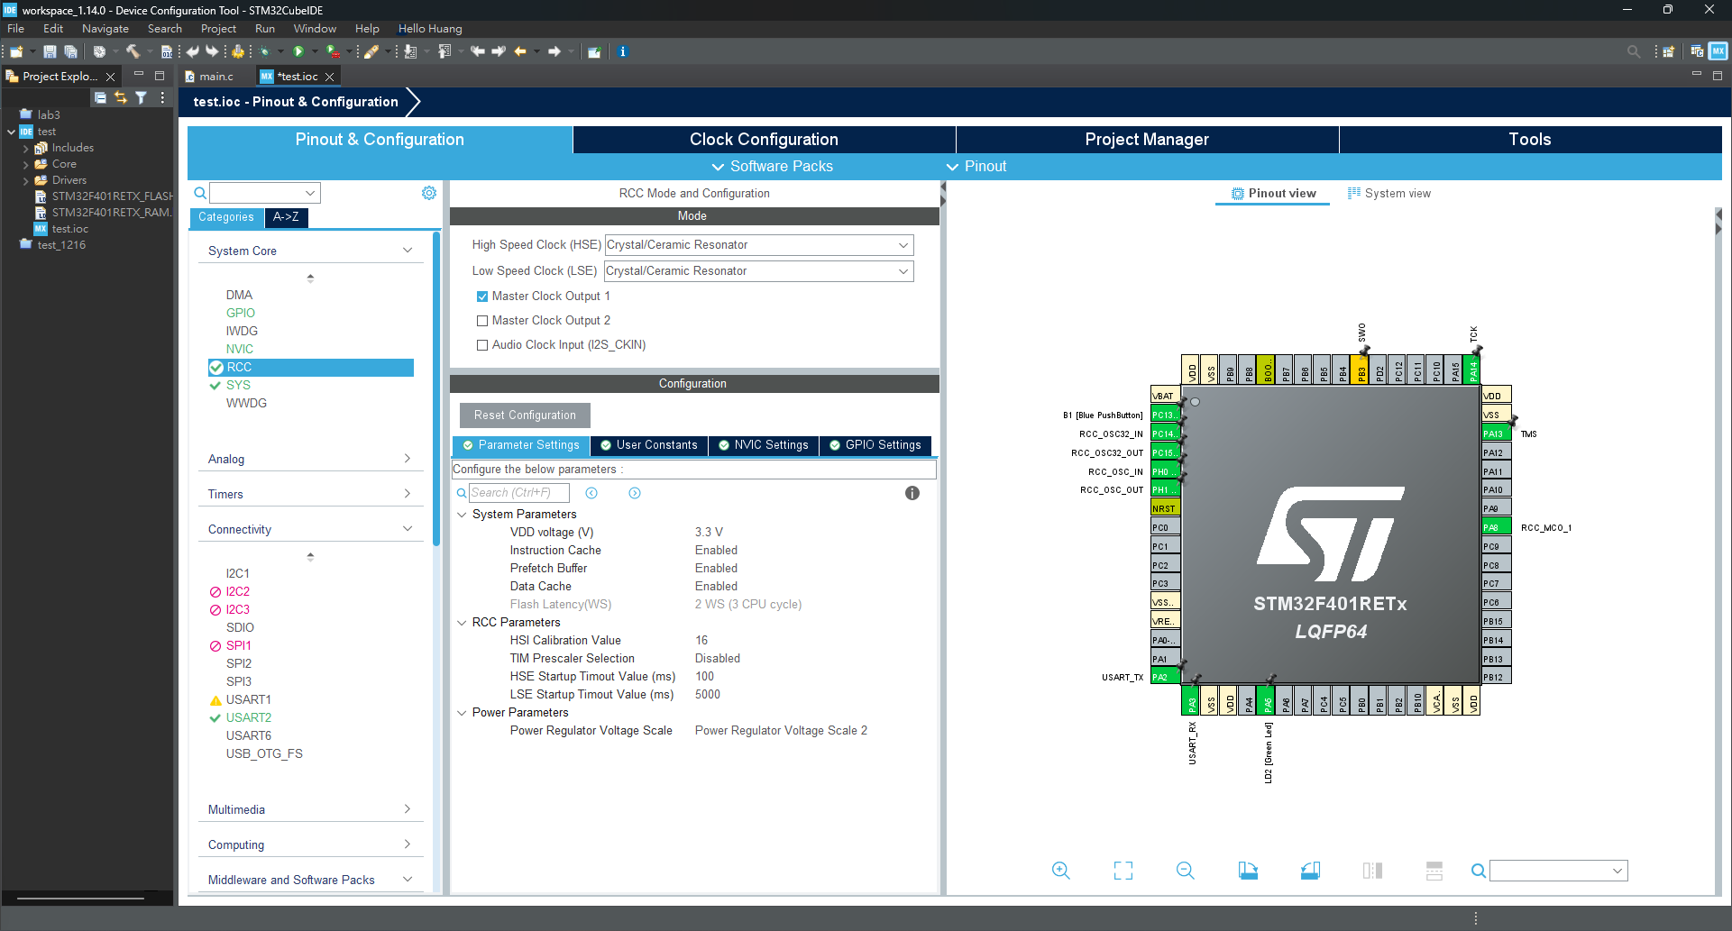
Reset and clock control (RCC)
Notes:
RCC 的完整英文描述是 ，Reset and clock control，重置(system, power, and backup reset)與時脈控制。
高速外部時脈訊號 (HSE)
低速外部時脈訊號 (LSE)
Crystal/Ceramic Resonator（石英/陶瓷 晶振）

Slide 38
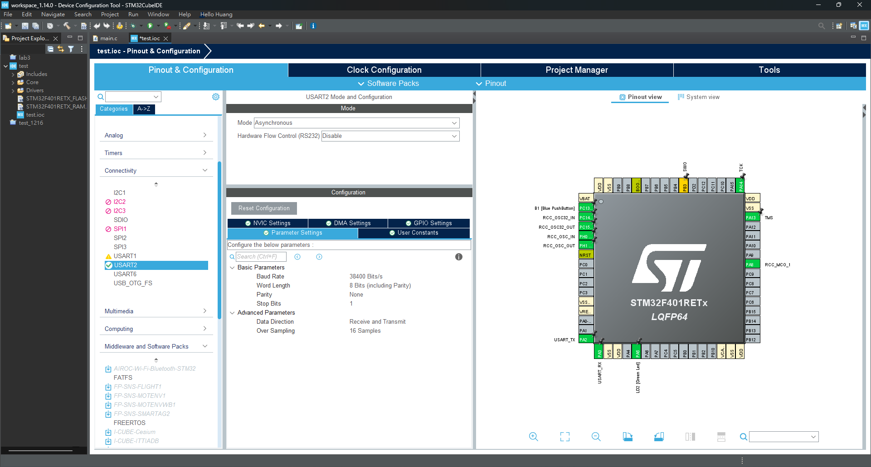
UART

Slide 39
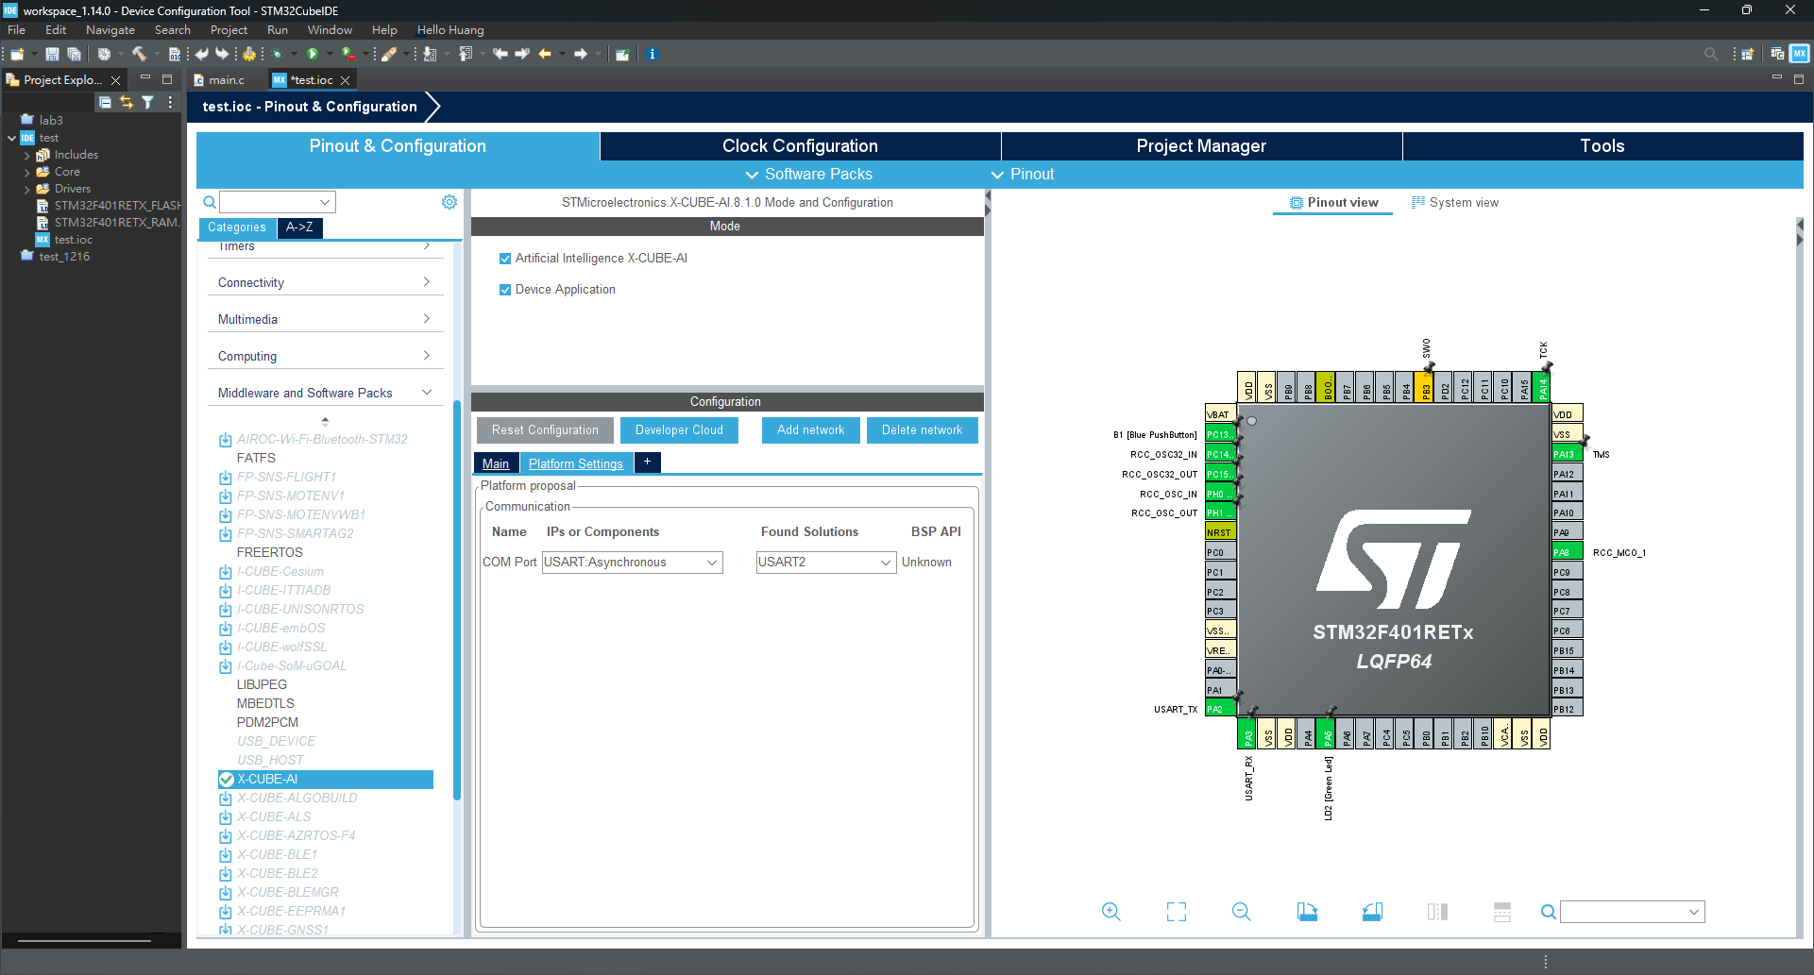
UART

Slide 40
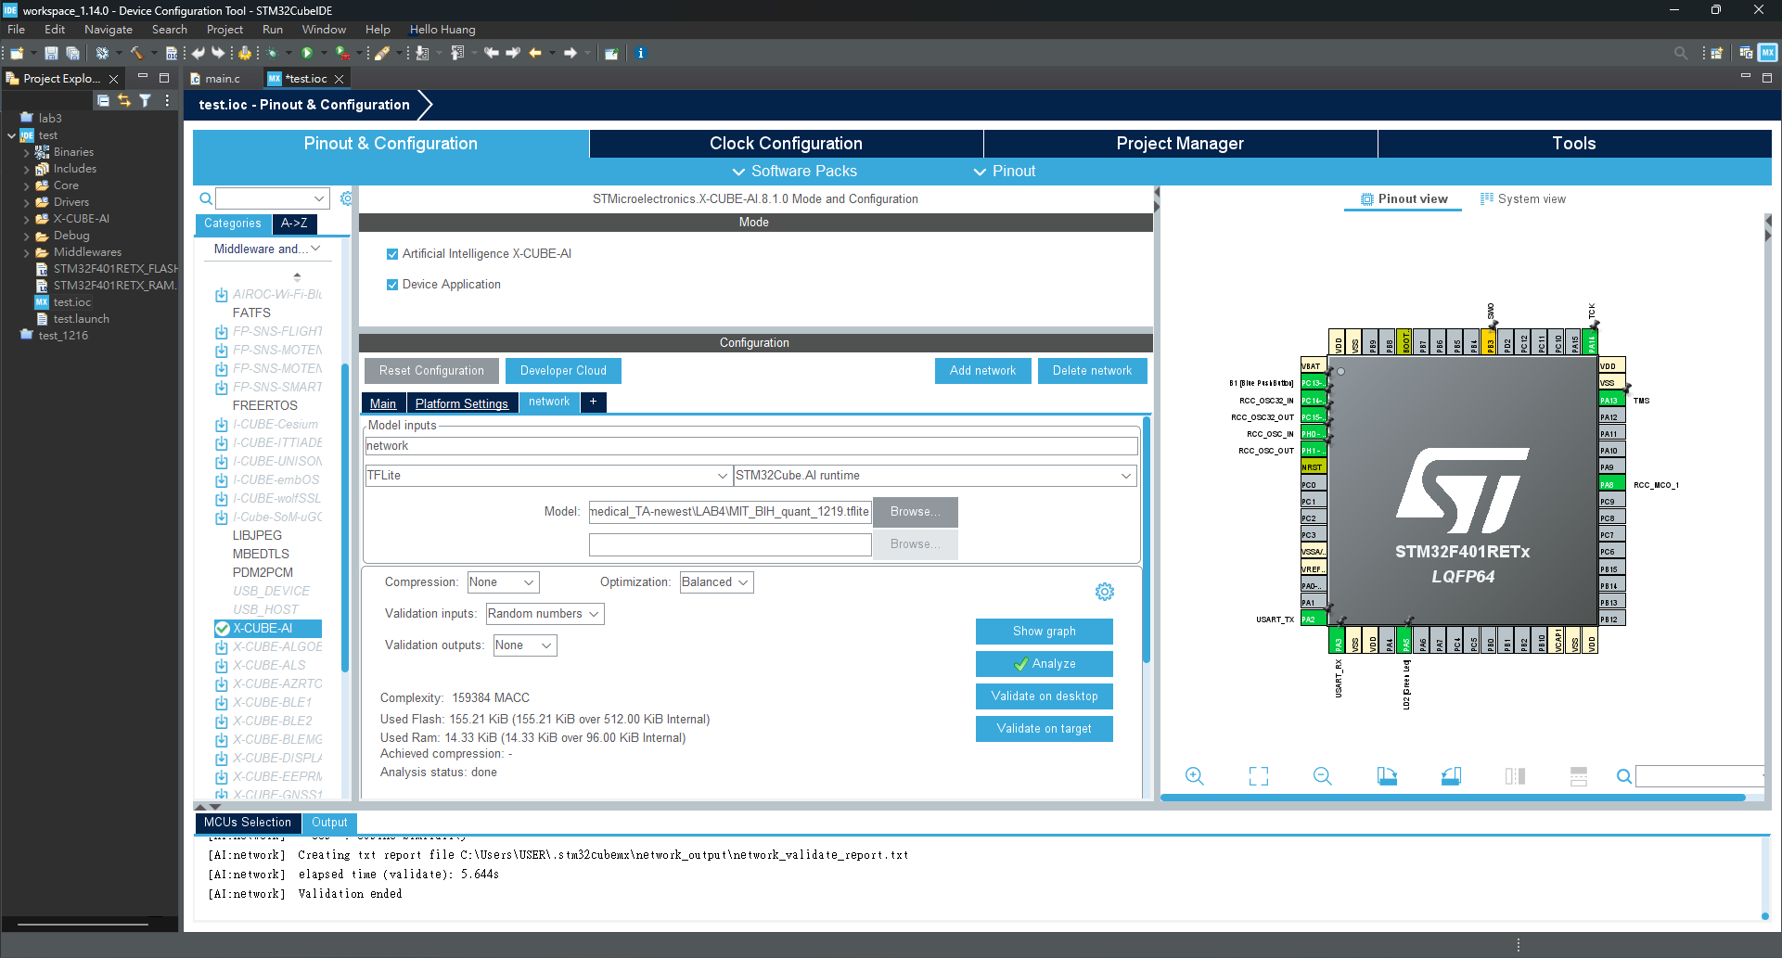
Add Model and Analyze

Slide 41
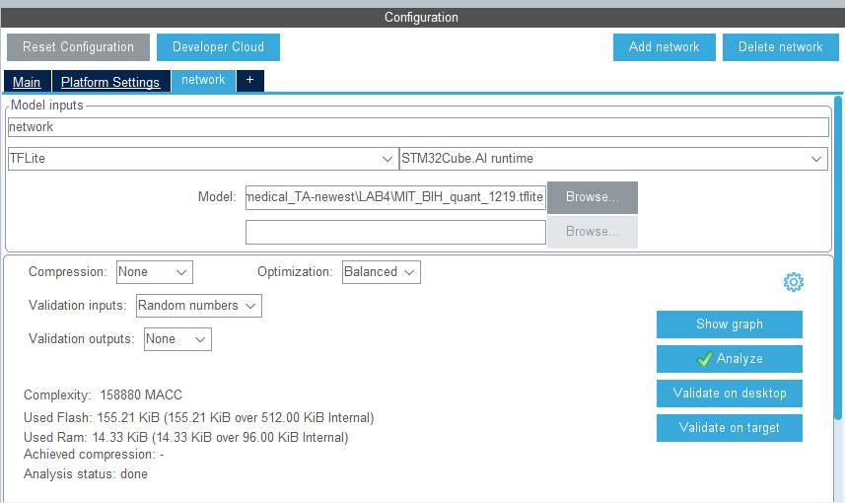
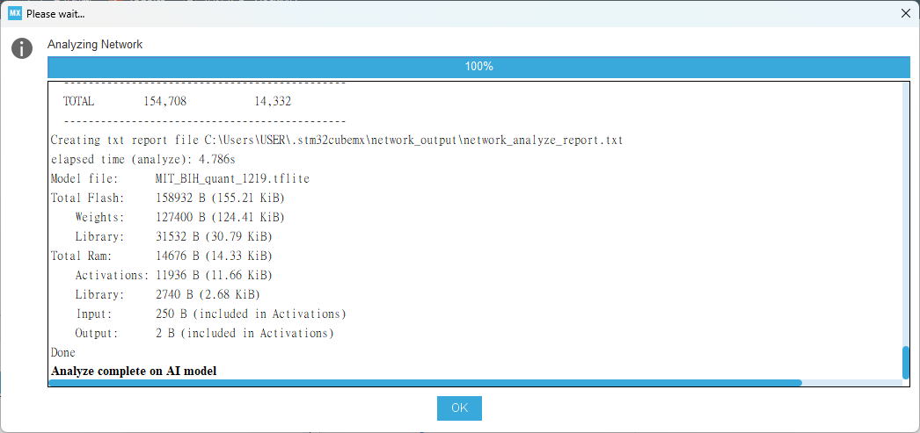
Analyze Output
The tool will infer the model's resource occupancy (ROM, RAM) based on the model and model parameters, allowing an assessment of whether the model can be deployed to a development board.

Slide 42
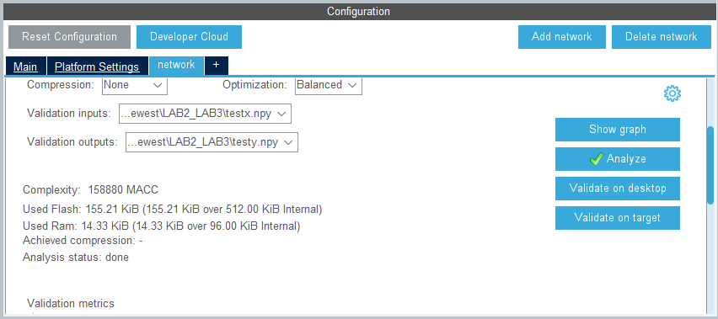
Validation on desktop
The verification data is the testx.npy and testy.npy files we just specified.

Slide 43
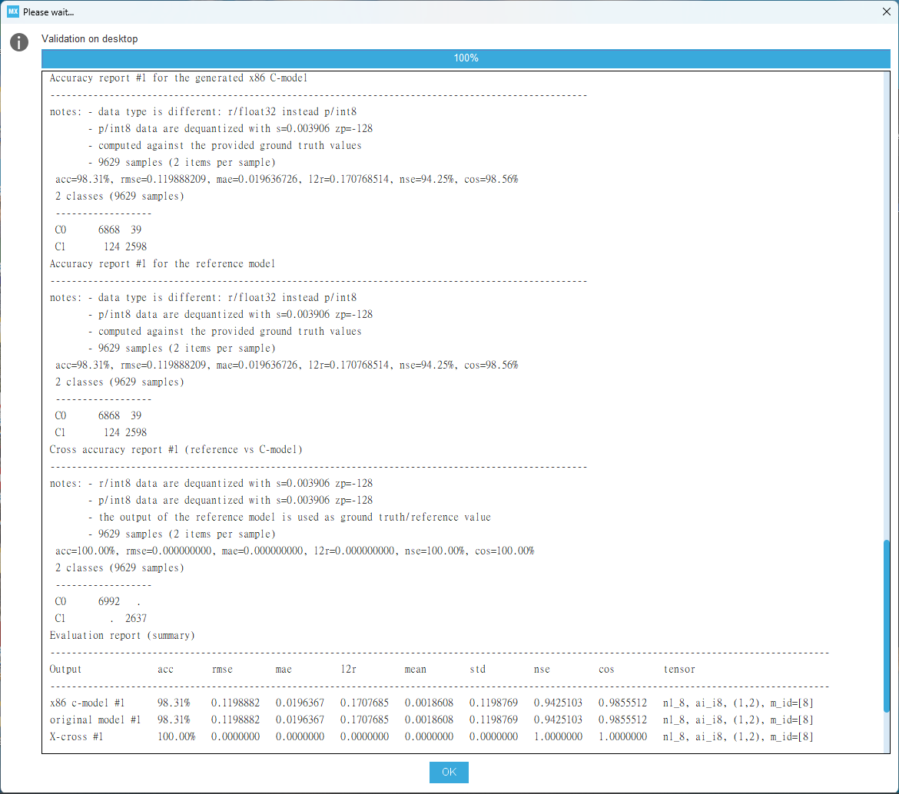
Validation on desktop
To verify the training model, we mainly verify the differences in computing resources, model accuracy, etc. before and after the verification between the original model and the model converted to C language support.
Notes:
沒有Accuracy 是因為我們範例使用的模型不是分類模型是回歸模型

Slide 44
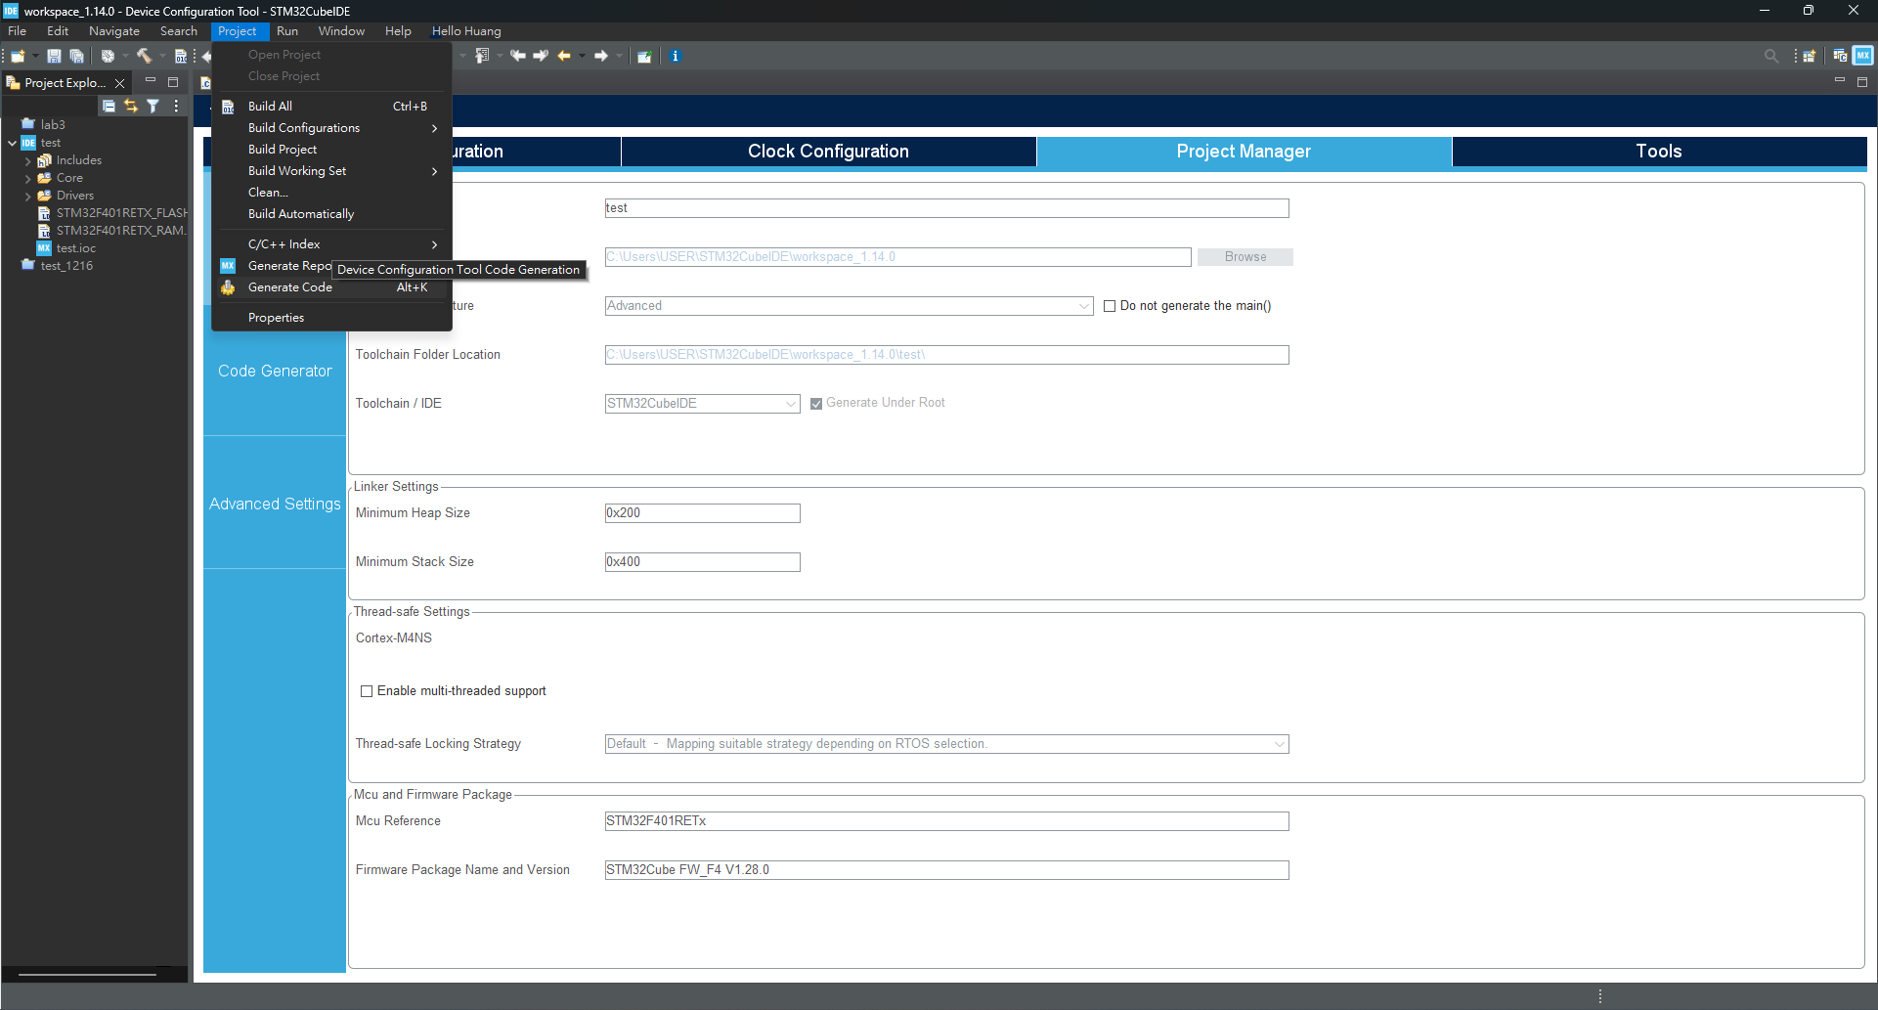
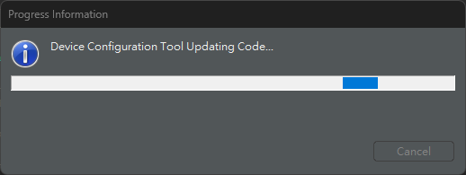
Generate Code

Slide 45
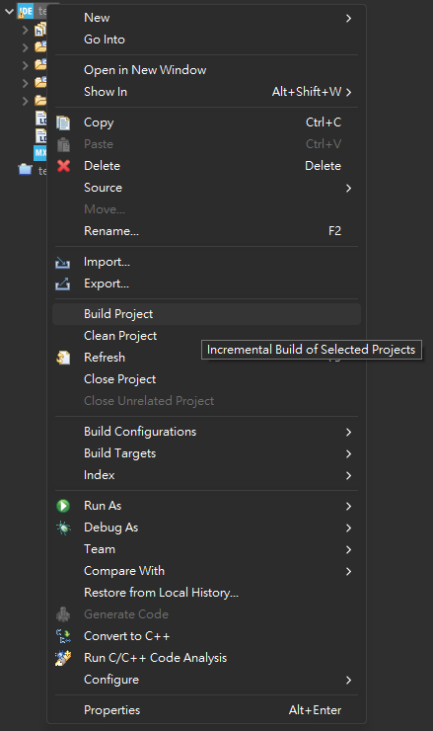
Build Project

Slide 46
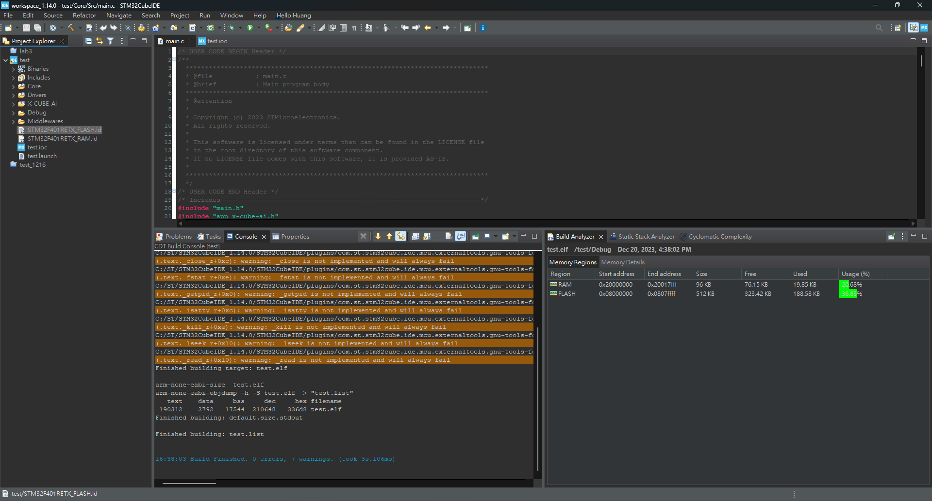
Build Project

Slide 47
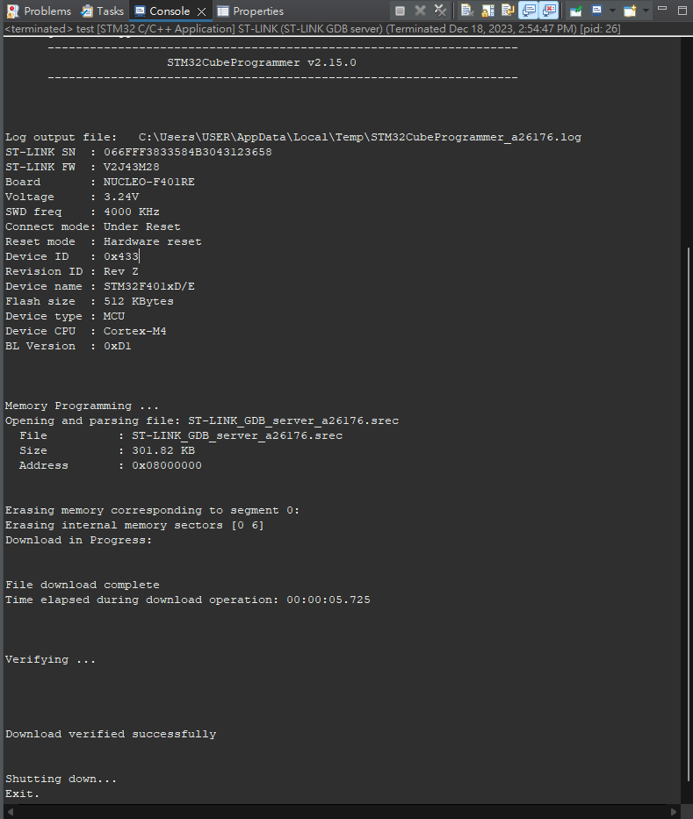
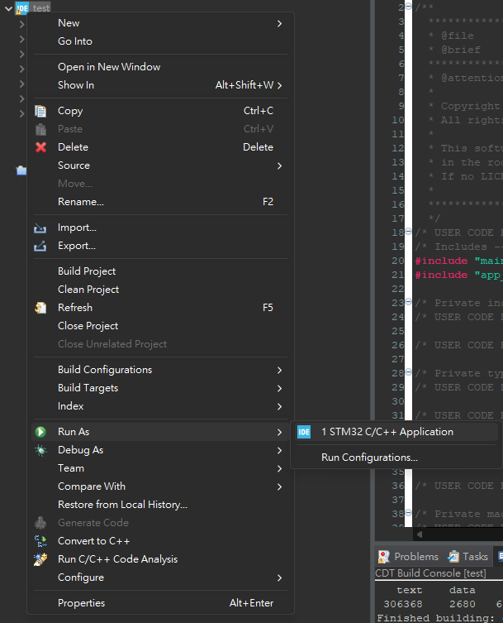
Build Project

Slide 48
Validation on target
The verification data is the testx.npy and testy.npy files we just specified.

Slide 49
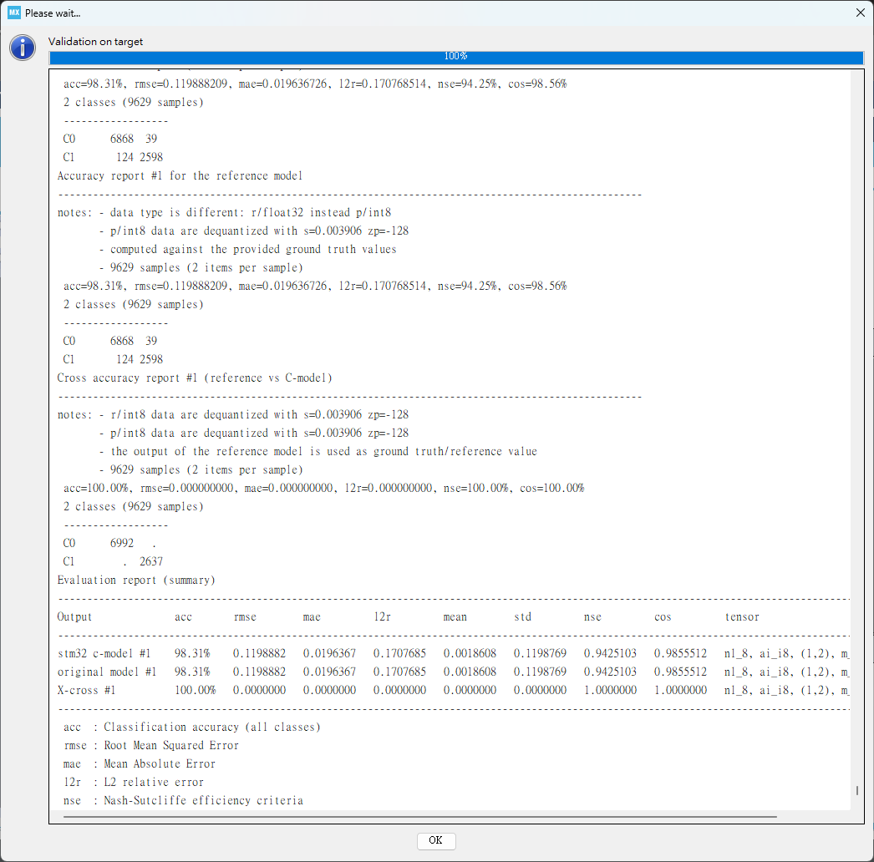
Validation on target
The model is successfully verified on the target board.

Slide 50
Demo time

